Slide 1
Longread DLPFC Visium meeting with Timp and Hicks lab
12/19/2023

Slide 2
Goal: Increase resolution on our current understanding of the transcript landscape in the dorsolateral pre-frontal cortex by identifying transcript isoforms with spatial awareness.
Method: Differential isoform expression analysis of data from long-read sequencing of cDNA generated by processing human brain tissue samples on the 10X Genomics Visium platform.
Steps:
Proof of concept
Barnyard experiment
Sample QC and enrichment
Library generation
Sequencing
Spatial/barcode analysis
2. Data acquisition
Deep sequencing of 4 DLPFC cDNA samples
Sample QC and enrichment
Library generation
Sequencing
3. Analysis
Compare isoform expression across brain layers
Demuxing
Spatial clustering
Isoform calling
Differential expression
4. Biological information/significance
Changes in isoform expression from common or functionally significant genes
5. Potentially use on additional disease cohort samples?

Slide 3
Problems/Questions
how we should be running BayesSpace pipeline differently? Are there suggestions on how to benchmark.
Do we keep low quality reads – given the clear clustering issues that are arising when keeping them.
Joining together across samples. Spatial approach or not?
How should I structure differential expression analysis – could potentially be best pathway for isoform discovery.
How to correctly utilize the illumina data as a benchmark.
Is CellCharter worth trying ?

Slide 4
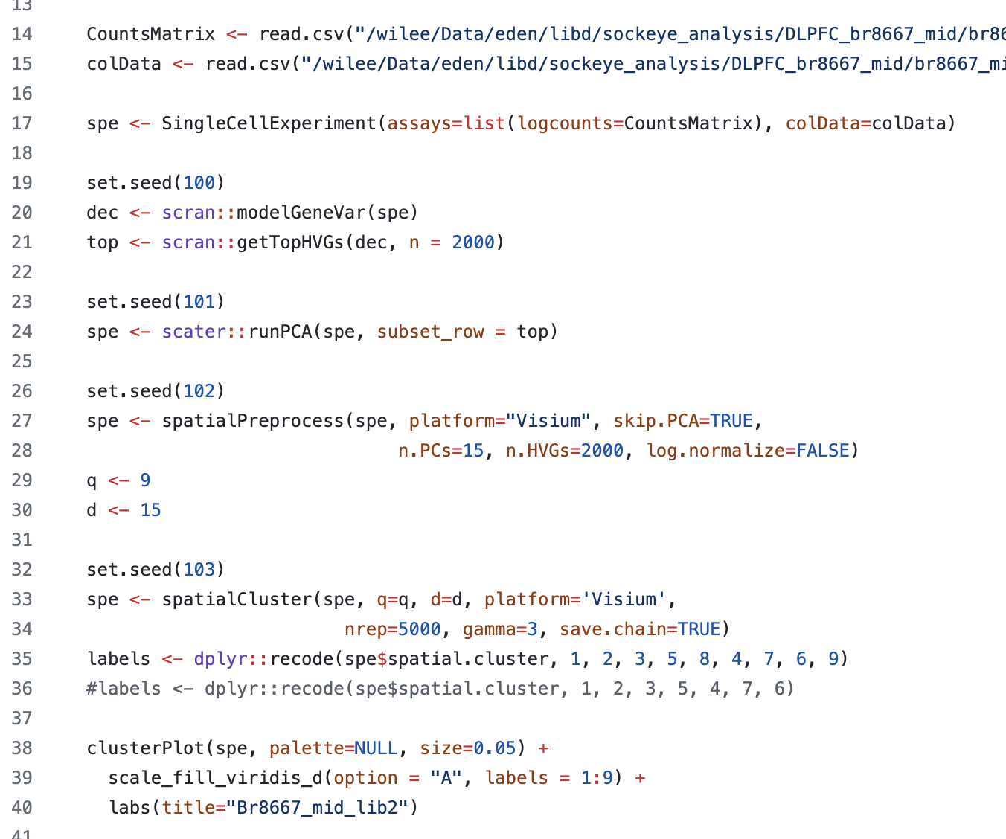
BayesSpace current pipeline
SpacialExperiment
runPCA on top2,000 HVGS
Spatial Preprocess w/ 15 PCs
spatialCluster (gamma=3, cluster=2/9)
Current methodology for assessing benchmarking pipeline is just looking at the figures for clustering smoothness

Slide 5
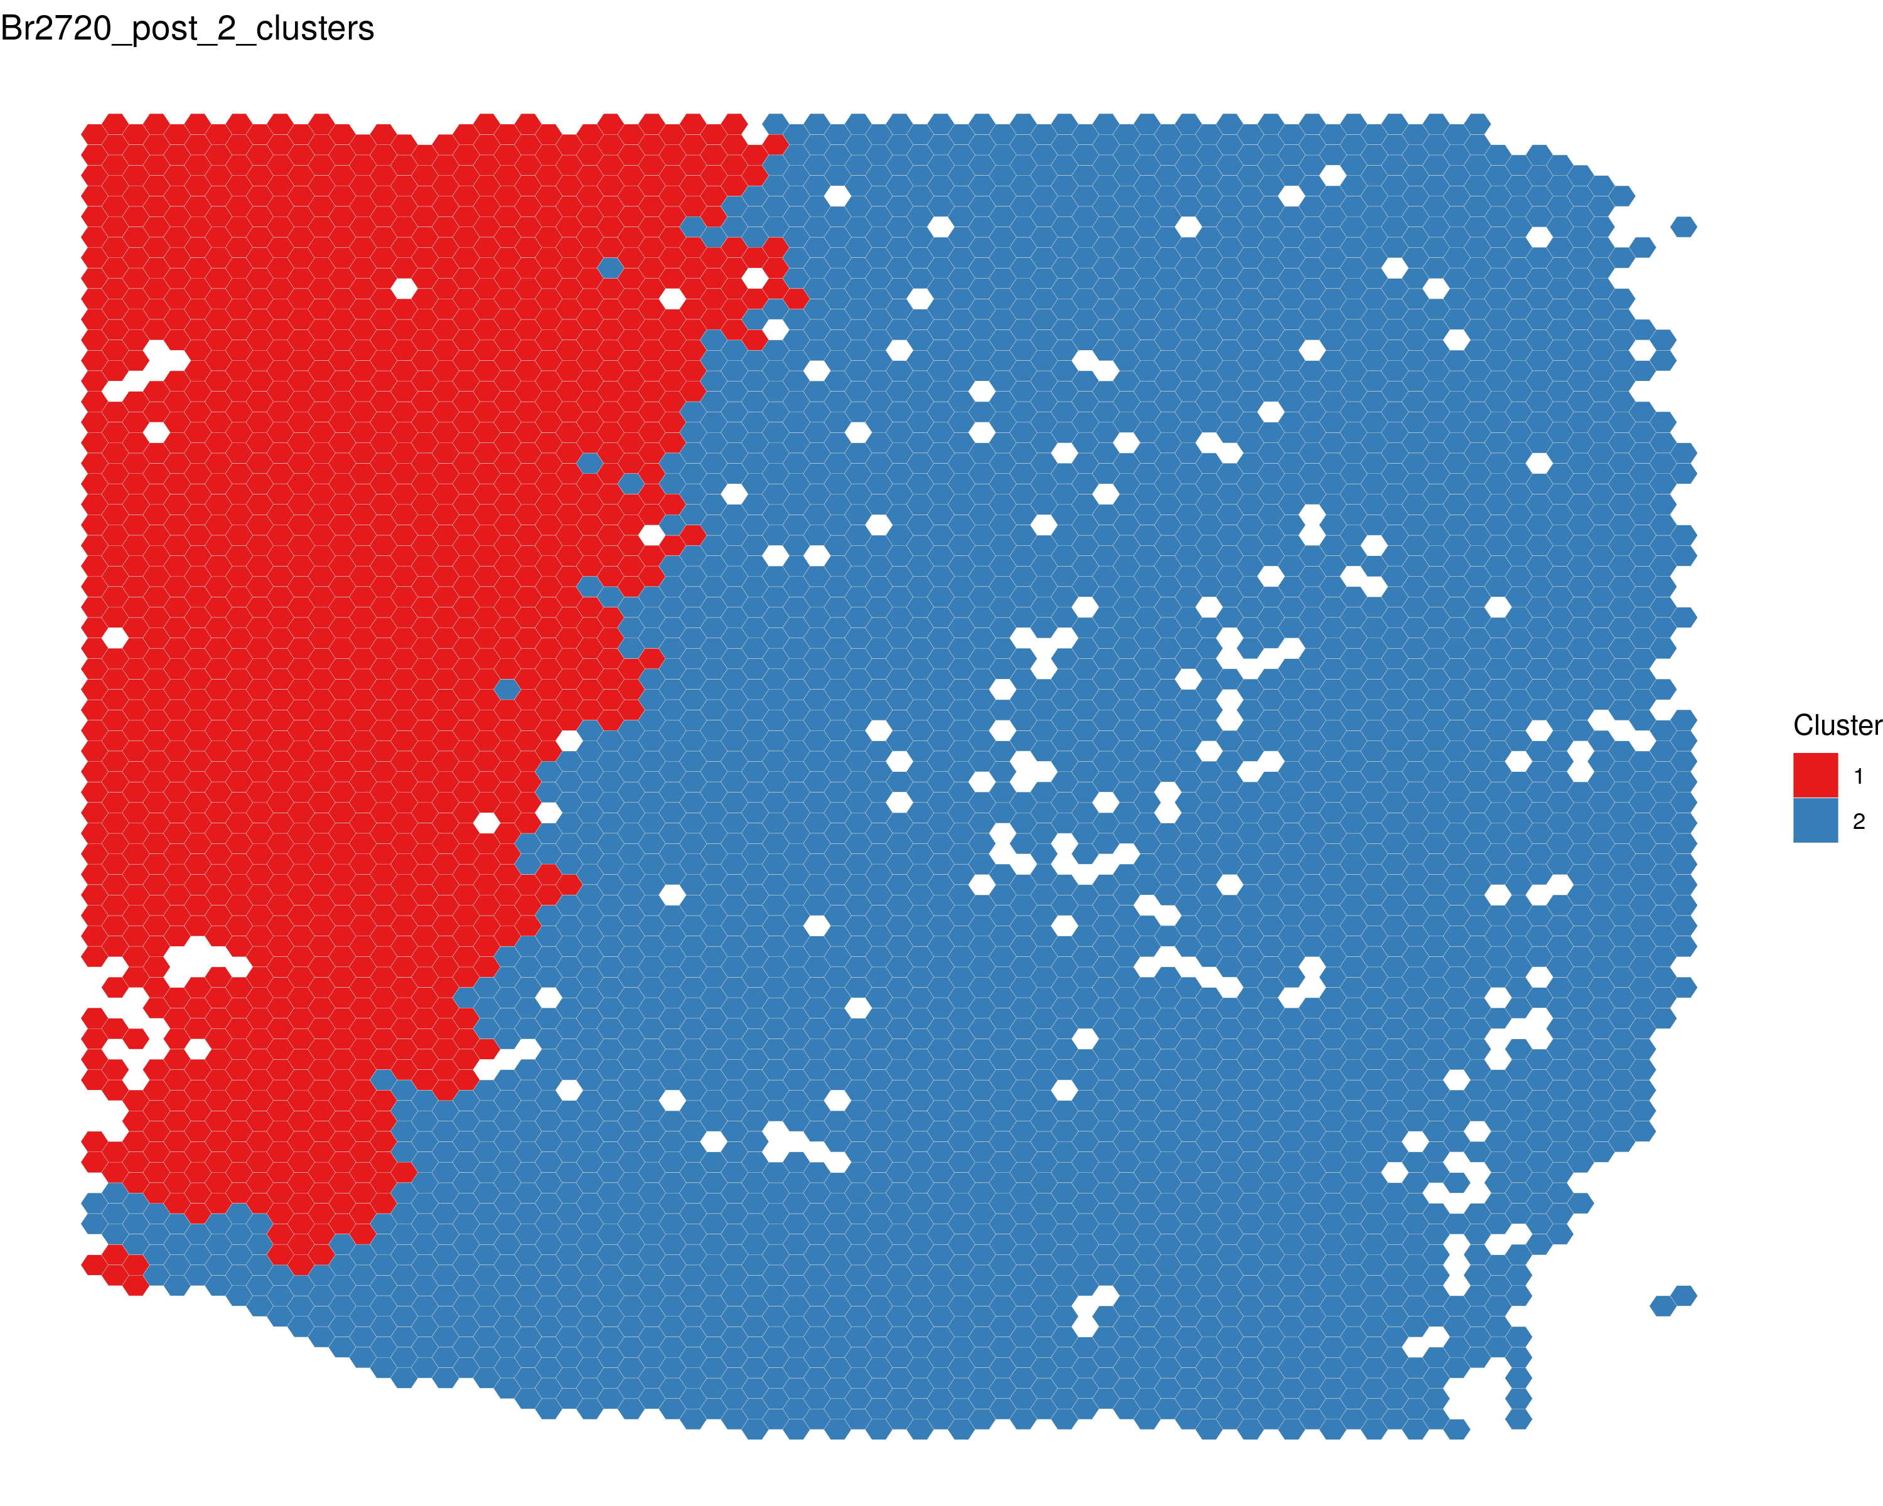
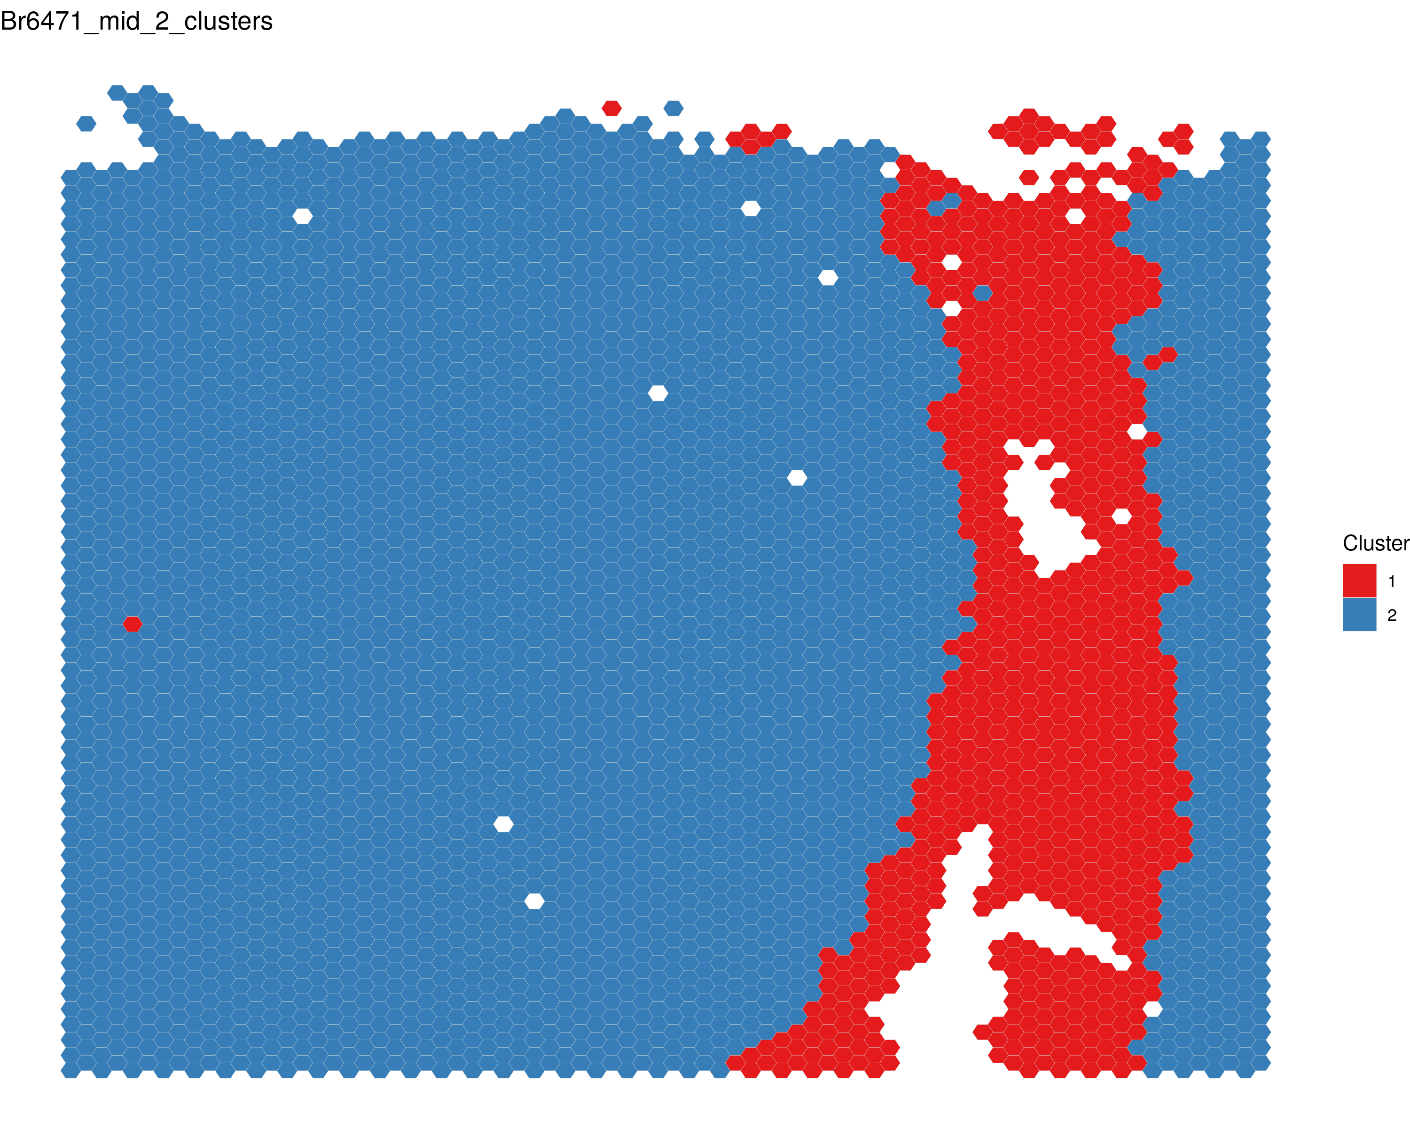
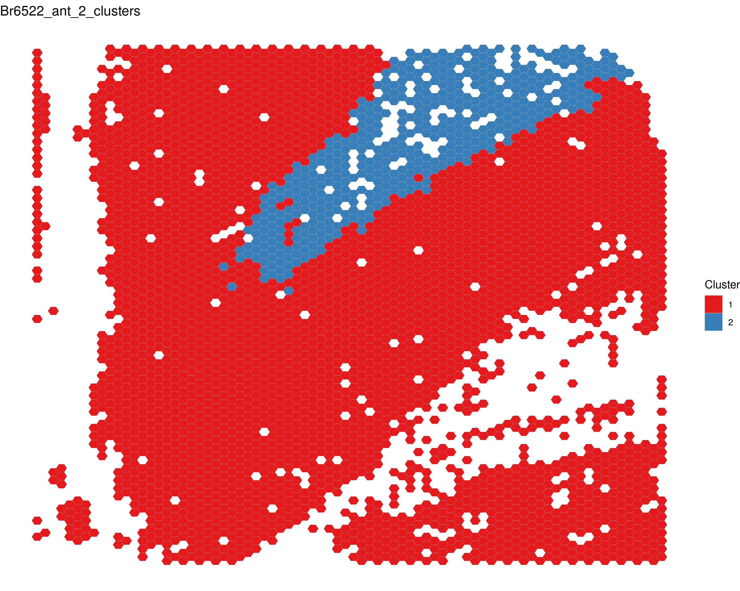
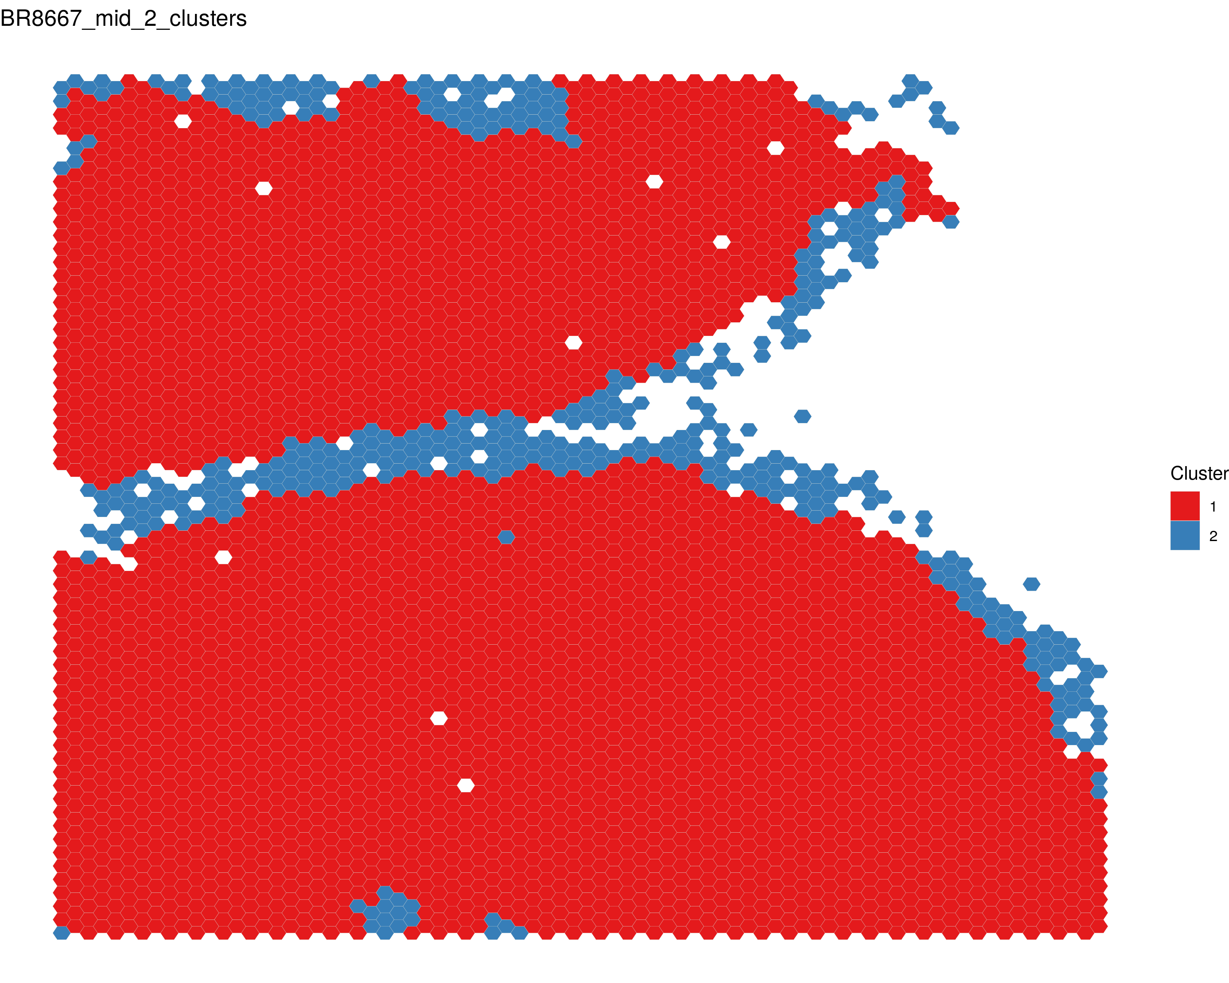
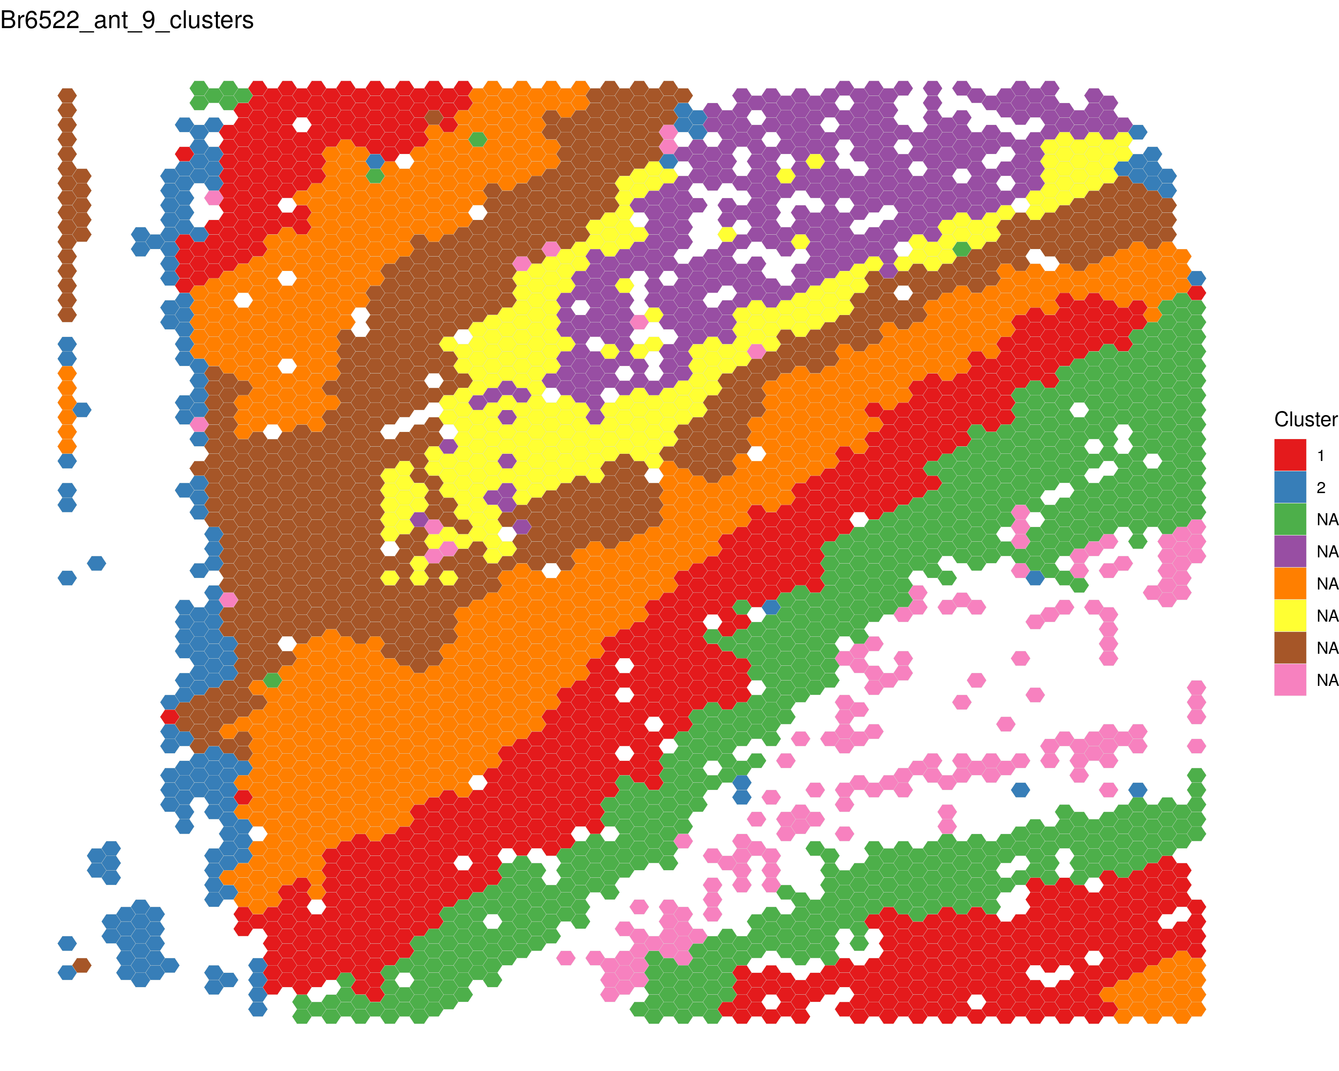
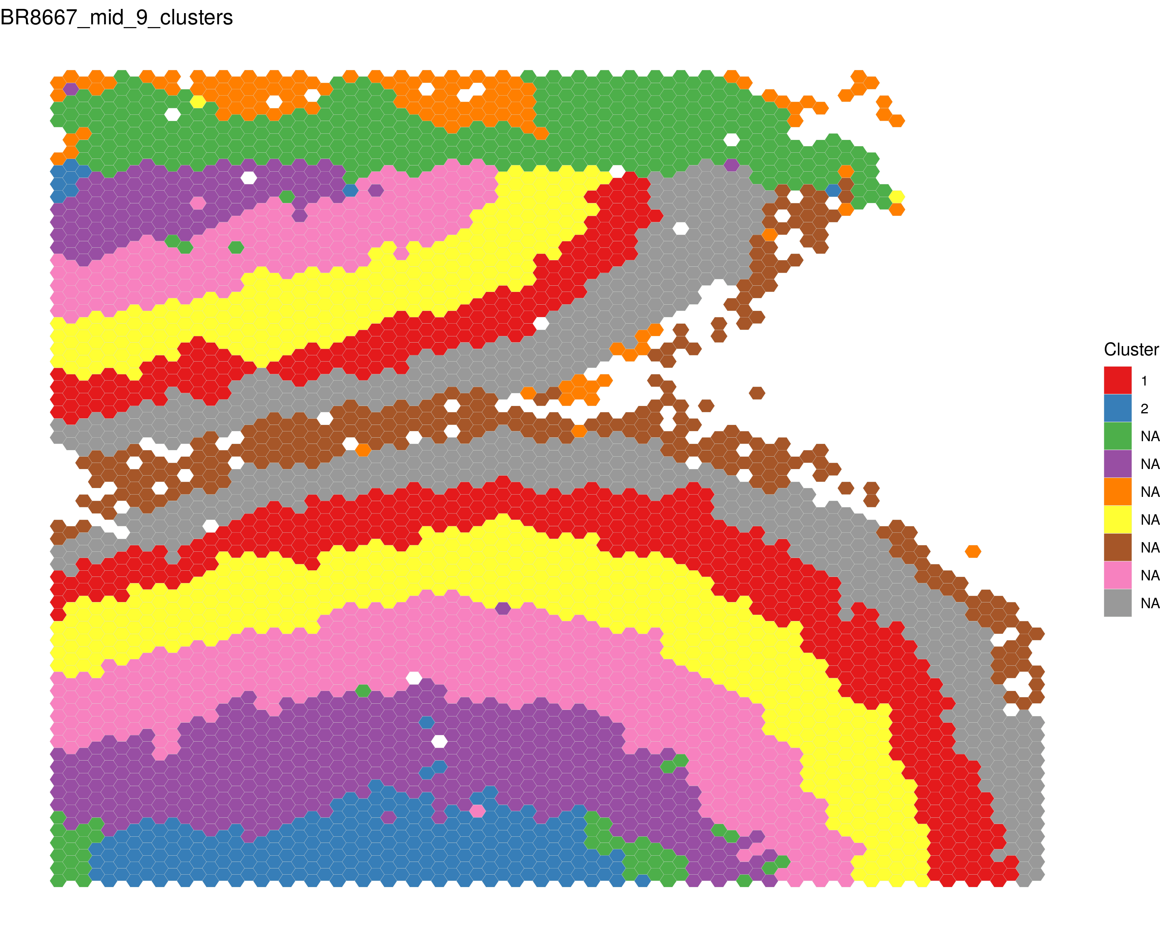
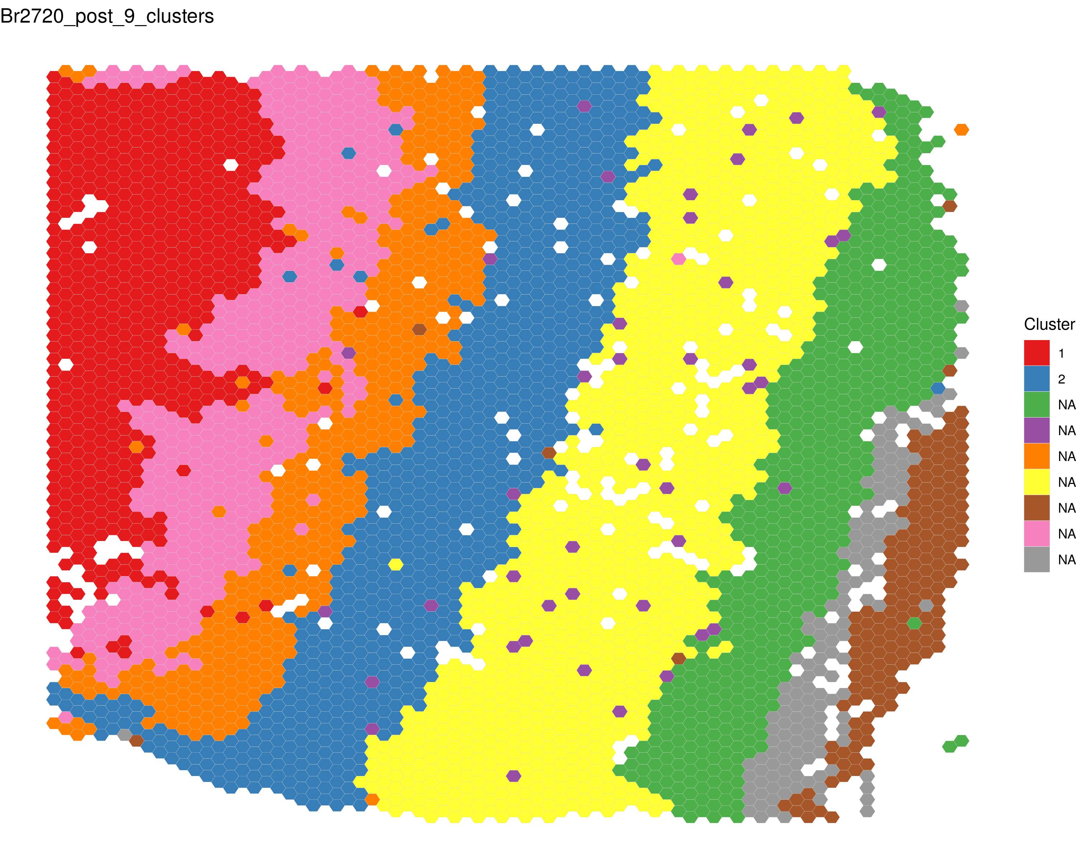
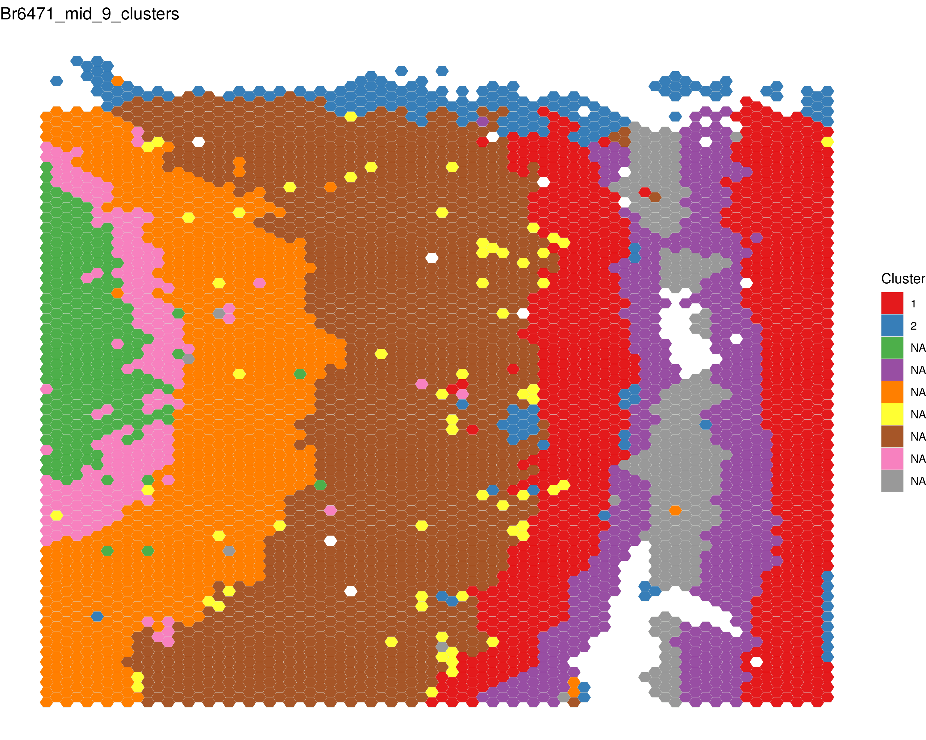
2 clusters vs 9 clusters
Br2720
Br6471
Br6522
Br8667
Bayesspace prefers 6/7 clusters

Slide 6
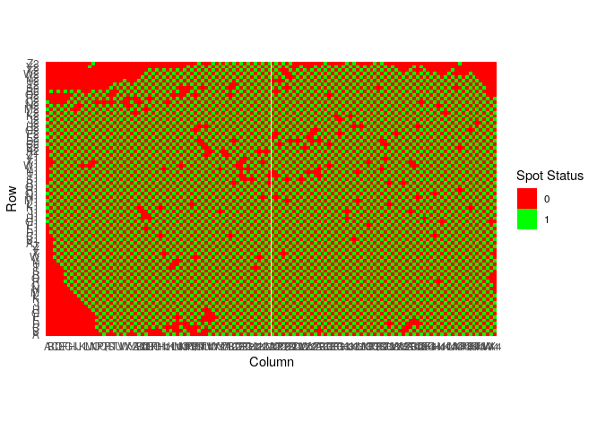
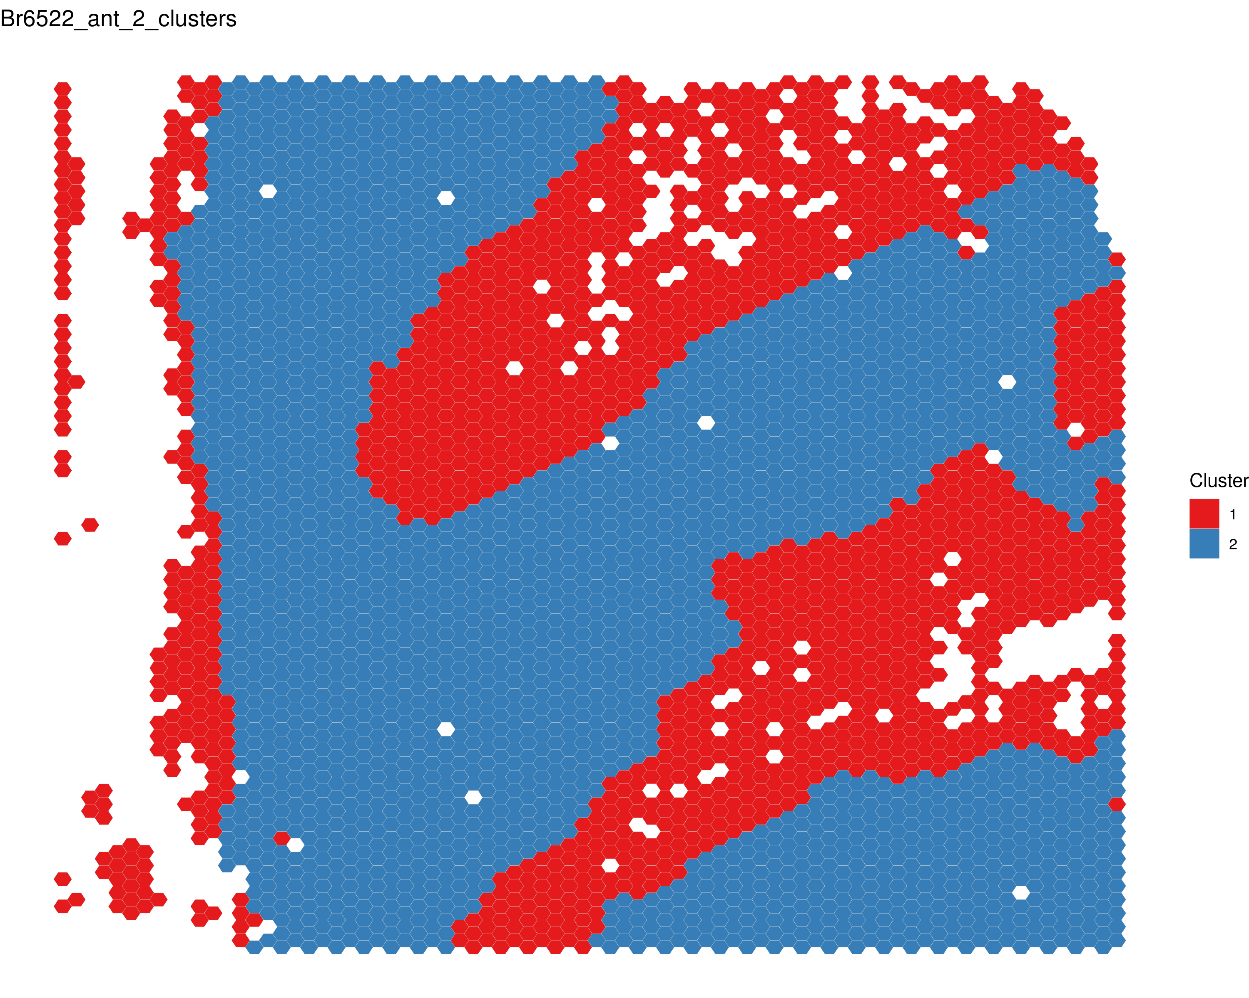
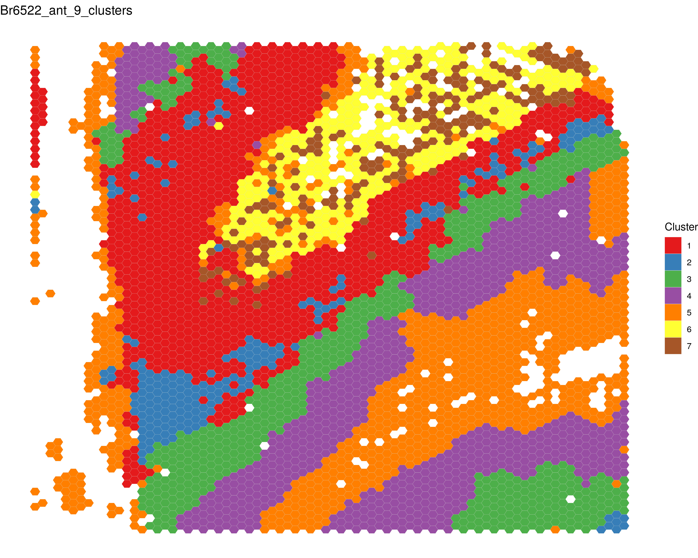
Why are spots not getting clustered?
Mapping of barcode coordinates
Sockeye Filtering:
Filter out barcodes with fewer than 25 reads
Filter out genes/transcripts with reads in fewer than 3 barcodes
Filter out barcodes with >20% MT reads
Normalize to 10,000 counts per barcode
K=2
Removing filter
Clearly low quality, shows very poor clustering
Should we be focusing on utilizing these low quality or are we fine removing them?
Removing filter
K=9

Slide 7
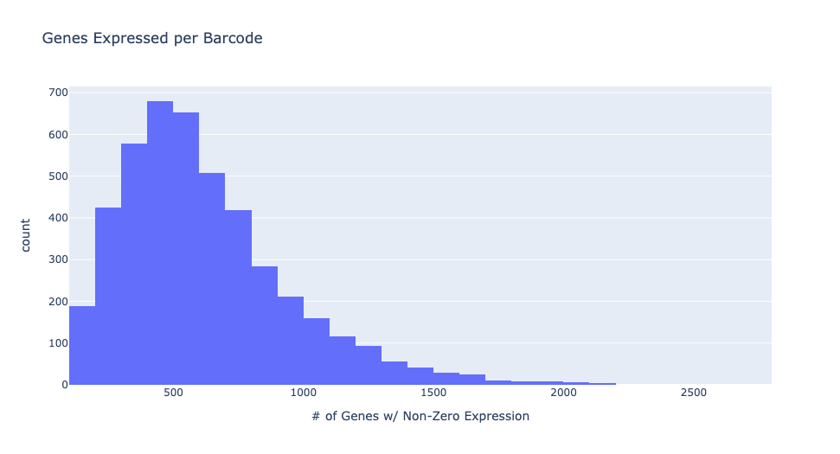
DE analysis: single-cell (Seurat) vs Pseudobulking (DEseq2)
Thoughts:
Is the quality of the individual barcodes sufficient to not have to combine them?
If we pseudo bulk- Is there a recommended method of comparing clusters across samples?
2a. Is it a good idea to cluster all samples together independent of spatial data?
DE can be a reliable method of novel isoform detection
Pseudobulking Gray Matter vs White Matter across 4 samples:

Slide 8
We want to show Nanopore works – how can we utilize Illumina data to most convincingly demonstrate that nanopore is comparable?
Show same genes are DE expressed between clusters?
Show figures are similar?
Show similar spatial expression patterns of key genes throughout sample?

Slide 9
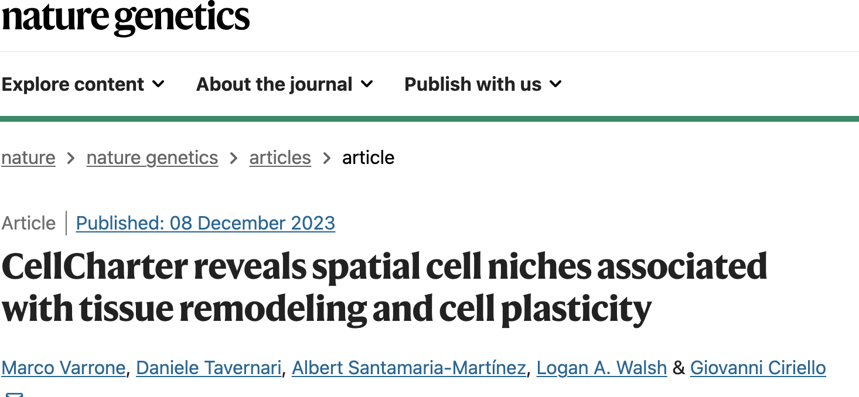
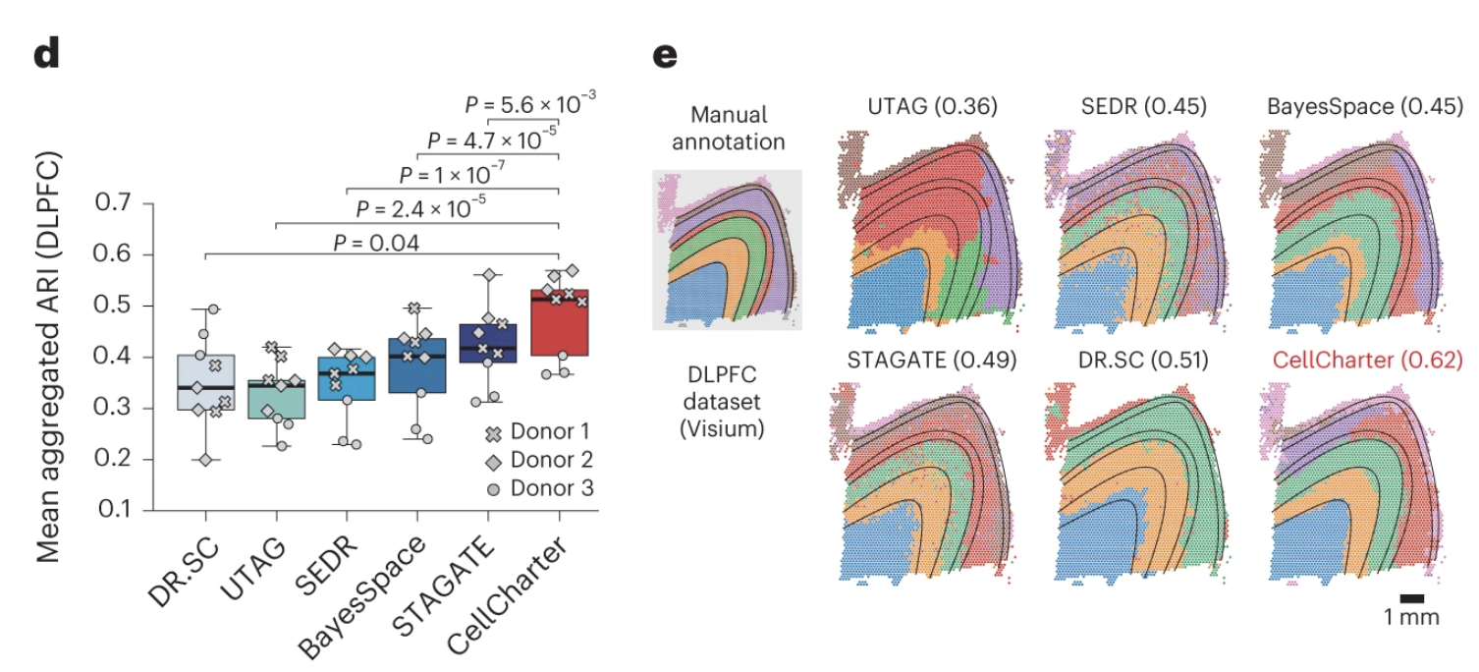
CellCharter?
Worth trying?

